Slide 1
Bacterial Skin Infection
By:
Dr. Aya Yousef Badran
Assistant Prof. of Dermatology & Venerology
Faculty of Medicine, Assiut University

Slide 2
Bacterial skin infections are very common diseases
Causes:
Staphylococcal infections
Impetigo
Ecthyma
Folliculitis
Furunculosis
Carbuncle
Streptococcal infections
Impetigo
Ecthyma
Erysipelas
Cellulitis

Slide 3
Impetigo
Infectious superficial pyogenic infection of skin.
AE: Staphylococci & streptococci
More common in childern.
Occurs mostly in summer.
Clinical types:
1- Non-bullous impetigo
2- Bullous impetigo

Slide 4
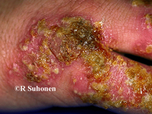
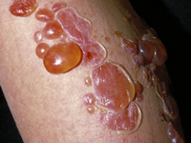
Non bullous impetigo
Bullous impetigo

Slide 5
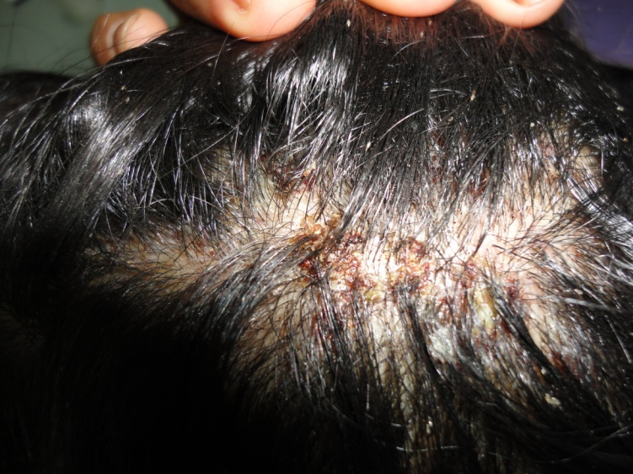
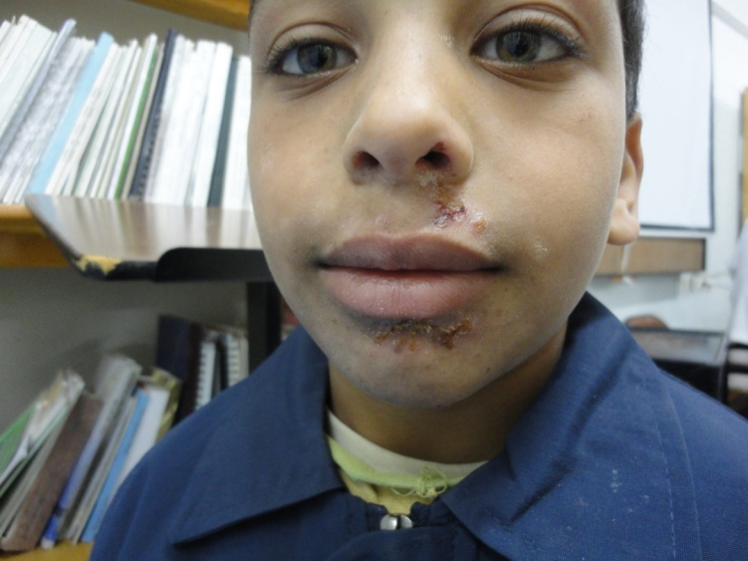
Non bullous impetigo

Slide 6
Clinical picture of non bullous type
Thin walled vesicle on erythematous base
Rupture & exude serum
then dry to form yellowish crust
The crust separate leave erythema
Fade without scar

Slide 7
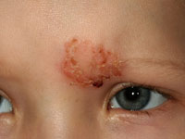
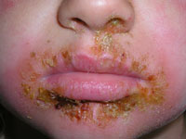
Site: common on face, neck, scalp, hand & extremities

Slide 8
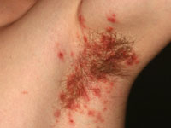
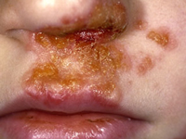

Slide 9
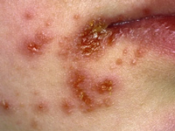
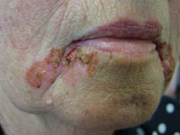

Slide 10
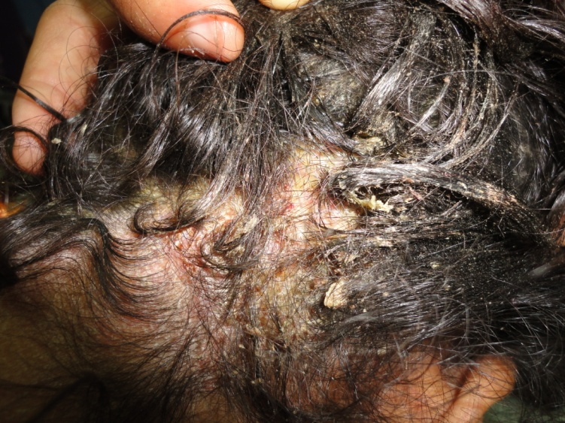
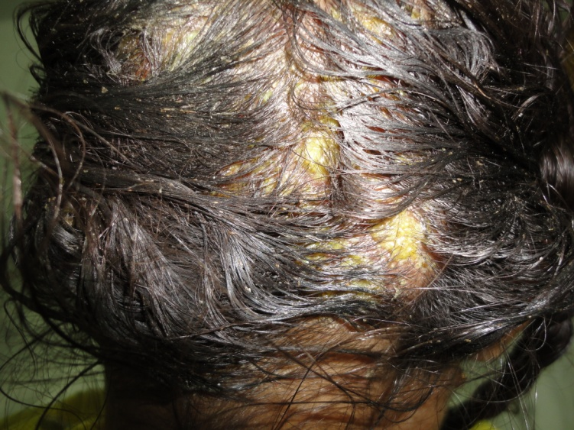

Slide 11
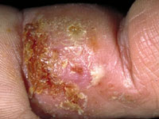
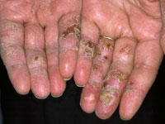

Slide 12
Bullous impetigo
bullae are fewer in number and much larger.
occur anywhere on the body.
Common in neonates.

Slide 13
Acute glomerulonephritis may occur as a complication of group A beta-hemolytic strept.
Treatment:
1- Control predisposing factors (itching, scabies, pediculosis)
2- Topical antibiotics ( alone in localized infections).
3- Systemic antibiotics (in severe infection and with lymphadenopathy).

Slide 14
Cellulitis & Erysipelas
Deep bacterial infection of the skin.
Clinical picture:
Fever, chills & malaise occur. The lesion show the 4 cardinal signs of inflammation (hotness, redness, pain & swelling) & lymphangitis and lymphadenopathy.
Site: face & legs are commonly affected.

Slide 15
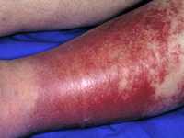
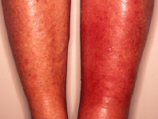
Cellulitis

Slide 16
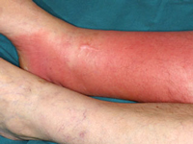
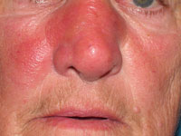
Cellulitis

Slide 17
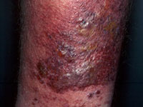
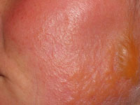
Erysipelas

Slide 18
Cellulitis & Erysipelas
Predisposing factors: wounds, fissures, ulcer or inflammatory lesion.
Complication: rare
Acute glomerulonephritis, lymphadenitis & subacute bacterial endocarditis.
Treatment: Systemic penicillins & cephalosporins.

Slide 19


Slide 20
Case 1
A female child 6 years old is complaining of multiple painful yellowish crusts on erythematous skin of her chin & cheeks of 1 wk duration. She has fever & submental lymphadenopathy in addition.
1- What’s your provisional diagnosis?
2-What’s the suitable treatment ?
3-What’s the possible complication to this case?

Slide 21
Case 2
A man 50 years old, diabetic, he is complaining of hot, red painful swollen erythema of his Rt. Leg. of 5 days duration. He had history of an accidental trauma leaved a wound in the same leg 10 days ago. He had fever, headache & malaise.
1- What’s your diagnosis?
2-How to treat this case?

Slide 22
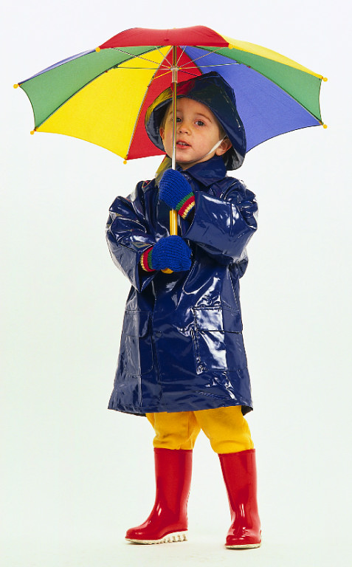
Thank You

